Slide 1
LHL SQL Project - Overview
Prepared by Jamie Lepard
Sept 25 2023

Slide 2
Project Overview
Objective of this project was to perform statistical modelling to test the potential relationship between bike-share information and Point of Interest characteristics

Slide 3
Goals included:
Developing API calls for City Bike to identify providers in a given location
Creating API calls for two location-based information sources (Yelp, Foursquare) to obtain POI data
Incorporating results into a local database (Sqlite3)
Develop and test a hypothesis for relationship between POI and City Bike data

Slide 4
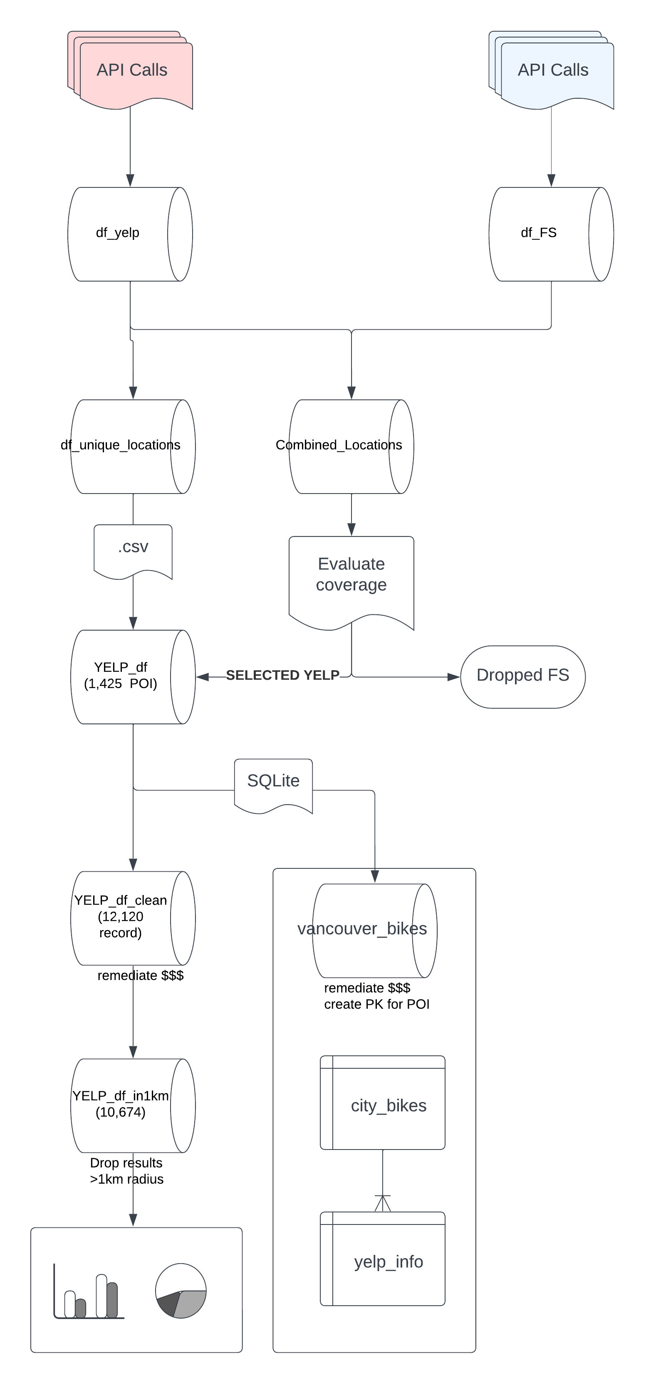
Data Engineering Process

Slide 5
Data Considerations
POI characteristics (Rating, Price,Distance to station)
Bike Station Characteristics (Spaces, Free bikes)
Temporal relationship between Bike activity and POI activity is very different.
Stations is very transactional (minute by minute)
POI is week over week.

Slide 6
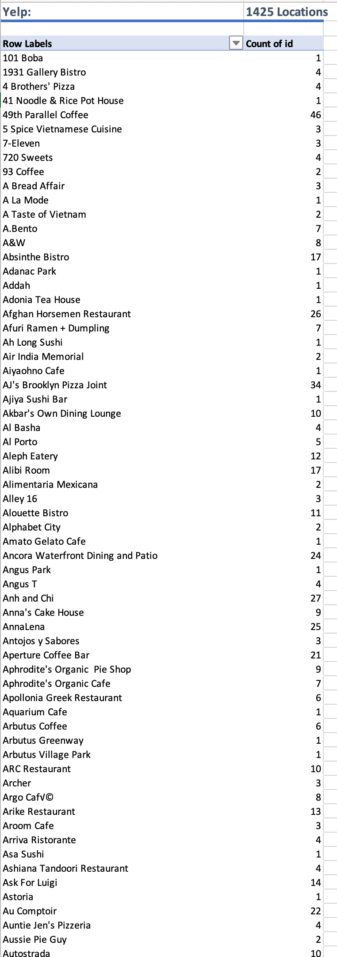
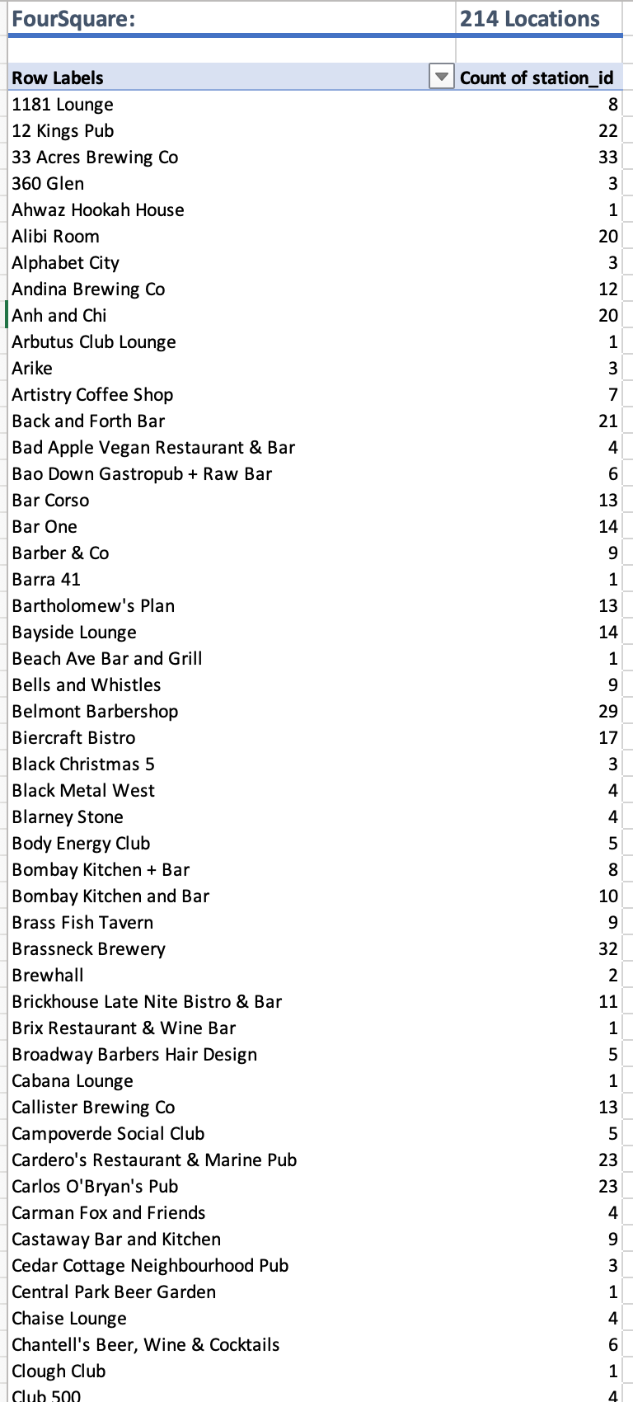
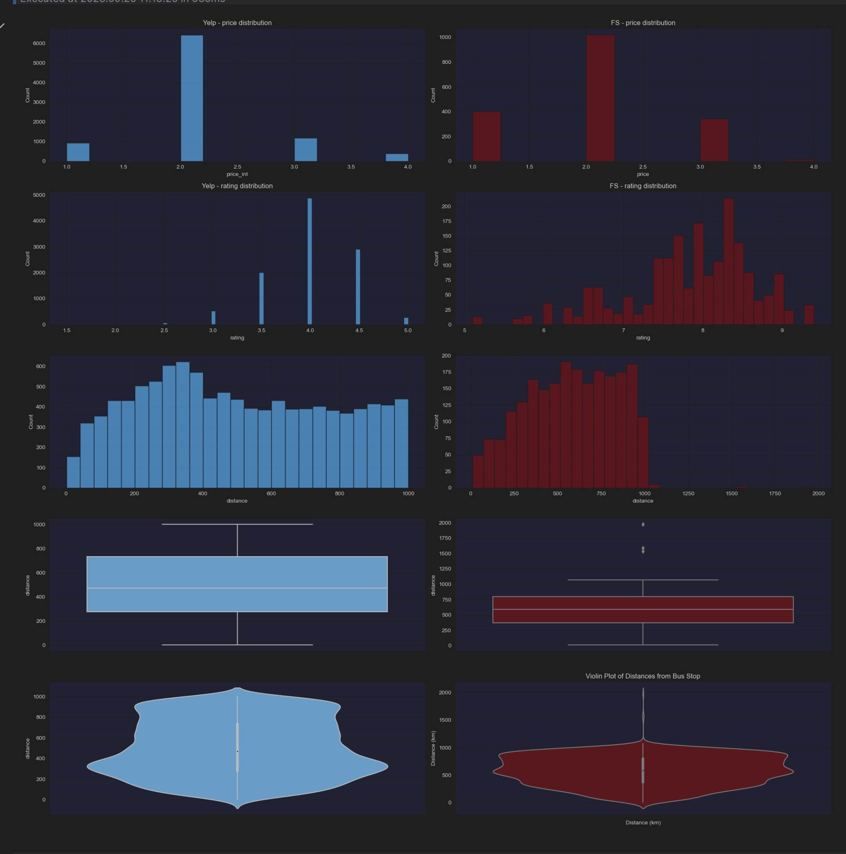
Coverage comparison
the Yelp API data provided considerably more data both in terms of results volume and depth of information.
For the same inputs (245 stations). FS Yielded ~1,400 unique POI, where as Yelp provided far fewer,

Slide 7
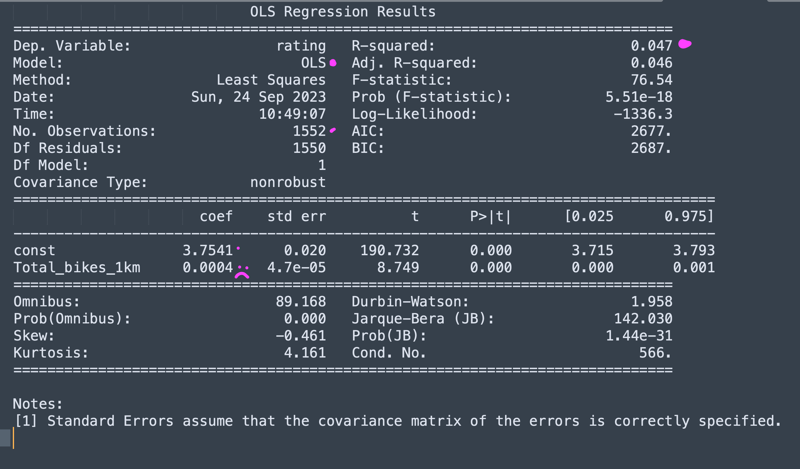
Linear Regression
H0: There is NO relationship between the number of bike within a 1km radius and a restaurant/bar's Rating
H1: There is a relationship between number of bikes and the restaurant/bar rating.

Slide 8
Linear Regression
Coefficient for Total_bikes_1km:
The coefficient value for 'Total_bikes_1km' is 0.0004 (ie the slope).
Implies that for every additional bike in the 1km radius, the rating is expected to increase by 0.0004, all else being equal.
Intercept (const):
The y-intercept is 3.7541 - means that even when the number of bikes within a 1km radius is 0, the predicted rating is 3.7541.
R-squared
> value is 0.047 indicates that only 4.7% of the variance in 'rating' is explained by the 'Total_bikes_1k
T-score and p-value:
The t-score is >8, which is very large and correspondingly, the p-value is v. small.

Slide 9
Thank you

